Slide 1
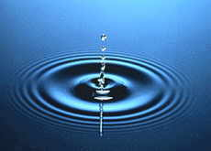
Lecture 1
Water
- Essential for life
- What has changed in the last few decades
- Life style- more water use (use and throw)
- Technological changes
- Anthropogenic pressures

Slide 2
Water shortages?
Wars in the 20th century were fought over oil…wars in the 21st century will be fought over water
“A lack of water is a key factor in encouraging terrorism, the Third World Water Forum in Kyoto has heard.” Ben Sutherland BBC News, March 2003

Slide 3
Data from NASA, the World Health Organization and other agencies
Severe water shortages affecting at least 400 million people today will affect 4 billion people by 2050
Adequate sanitation facilities are lacking for 2.4 billion people, about 40% of humankind.
Half of all coastal regions, where 1 billion people live, have degraded through overdevelopment or pollution

Slide 4
Water scarcity scenario- India
Chennai and Mumbai at present are short of 300 – 400 MLD. Delhi it is 500 MLD(million litres per day)
Present 30% of population in urban centres- prediction by 2025 it will be 50%
Water Stress- per capita availab. in 1955 was 5022 cum and 1990 was 2464 cum(cubic metre)
Bottled water industry business 1000 crore
Water shortage – private suppliers

Slide 5
Water shortage: water poverty
Increasing population
Increase use in agriculture, industry and cities (groundwater overdraft: water removed from land quicker than it can be replaced): water quality ?
Inefficient use
Unequal distribution
Pollution

Slide 6
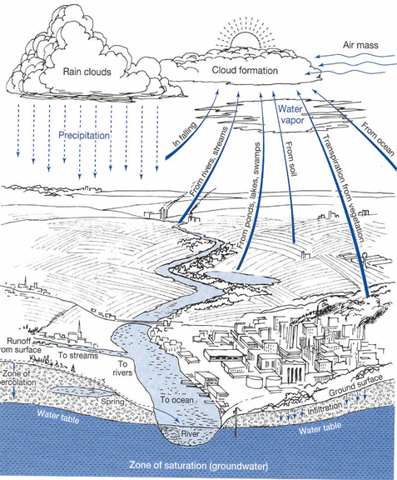
Water (hydrological) cycle
Like a nutrient cycle; water is recycled
Powered by solar energy (causes evaporation: water movement into atmosphere) and gravity (pulls water down as rain and snow into streams, rivers, etc..)

Slide 7
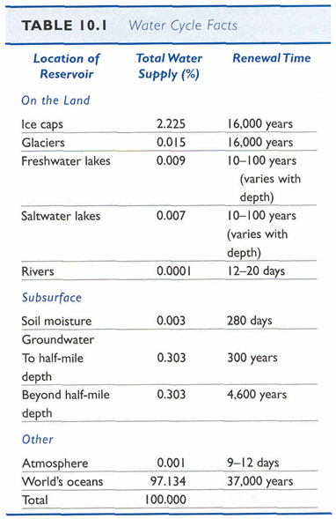
Water (hydrological) cycle
Water moves but is also held for a time as groundwater, in polar ice caps and glaciers, in atmosphere or in oceans and aquatic bodies
Replacement period / renewal time

Slide 8
Ocean
70% of earth’s surface and 97% of total water
Source of most rain
Precipitation
Clouds formed through evaporation transport water long distances

Slide 9
Organisms
70% of most organisms is water
Critically important for many biological functions
Lose 12% of water: death

Slide 10
Evaporation and Transpiration
~2/3 of rain is released back to the atmosphere
Evaporation from water bodies, transpiration from plants
Surface Water
Rain ends up in water bodies
Some flows to ground water

Slide 11
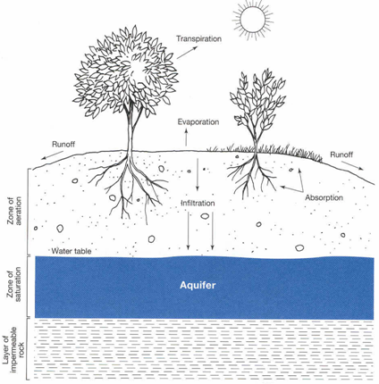
Groundwater
Rain and snowmelt seep down through soil (infliltration) through the zone of aeration (pores have air and water)
Remain water filters down to zone of saturation (pores saturated with water) eventually stopped by impermeable rock forming aquifers

Slide 12
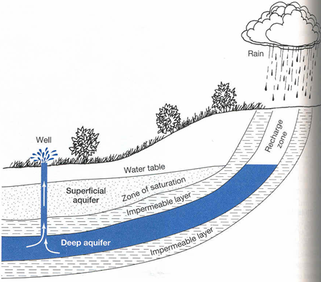
Water table is the upper level of the zone of saturation, source of water for wells
Varies with rainfall and withdrawal
Aquifer recharge zone is location for refilling water table

Slide 13
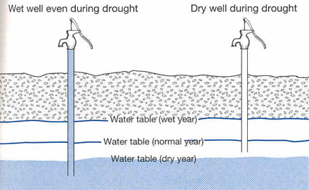
Water tables
Rate of recharge varies, some take 100,000s of years to fill (fossil groundwater)
97% of freshwater is groundwater
Source of drinking and irrigation water

Slide 14
Flooding
Natural event, but getting worse due to landscape changes and climate change (?)
Surface runoff: made worse by deforestation and roads, rooftops, etc.
Cause massive damage

Slide 15
Preventing and controlling floods
Measuring snowpack to predict floods
Levees (embankment built to prevent overflow of river)
Dredging (streambed aggradation)(clear bed of river or other area of water)
Dams

Slide 16
Disadvantage of big dams
Extremely expensive
Prime agricultural land is flooded
Scenic beauty is destroyed
Natural habitat is affected
Excessive water losses because of evaporation and seepage
Life of dam shortened by siltation
Collapse of a dam?

Slide 17
Preventing and controlling floods
Stream channelization(redirecting stream)
Protecting watersheds(area of land seperating rivers)
Zoning of floodplains (identifying the land which may be covered by floodwater)

Slide 18
Drought
Exists if rainfall is substantially below the average for 21 or more days
More common than believed, varies geographical
Cause problems for humans and wildlife

Slide 19
Increasing water supplies
Conservation: cost-effective and environmentally friendly
  Farm: water use (reduce seepage loses, increase drip irrigation, heat sensors)
  Industry
  Home

Slide 20
Increasing water supplies
2) Reclamation of sewage water
  99% of sewage is water
  Can be reused, often cleaner than source water
  Gray water

Slide 21
Increasing water supplies
3) Developing groundwater resources
-likely less sustainable
-can try to recharge with surface water in good years

Slide 22
Increasing water supplies
3) Desalination
  Removing salt from seawater to produce potable water
  Very important in middle east
  Expensive, economically viable if water has to be pumped > 90 miles
  Lot’s of energy and salt

Slide 23
Increasing water supplies
4) Developing salt- and water-resistant crops
  Salt-resistant plants open oceans as water source and farmlands high in salt content
  Some plant species survive drought

Slide 24
Increasing water supplies
5) Rainmaking
  Cloud seeding (sliver iodide)
  Can increase water supply in some regions by >50%
  Problems: high cost, shift regions of rain, change patterns

Slide 25
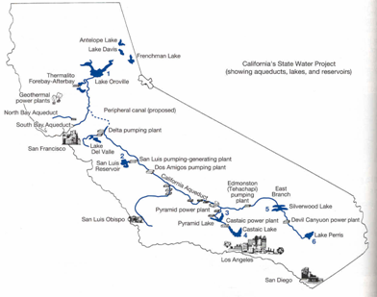
Increasing water supplies
6) Diversion
  Transporting water from one region to another by pipelines or canals
  High money and environmental costs
  Interlinking of rivers

Slide 26
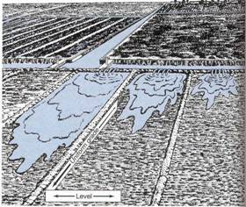
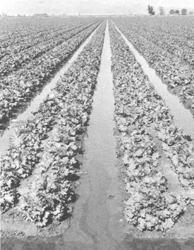
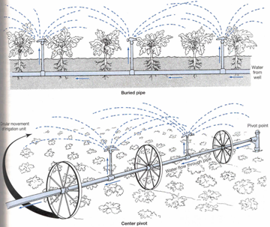
Methods of irrigation
Figure 10.20
Sheet and flood
Furrow
Sprinkler
Drip

Slide 27
Irrigation Issues
Water loss
Salinization and waterlogging
Depletion of groundwater and surface water
Sale of water rights

Slide 28
Domestic water use?
Change in life style
one toilet flush: 12 litres water gone
Preventing losses in distribution system
Industries can be promoted to recycle water
Rain-water harvesting

Slide 29
From the previous presentation it is clear that there are mainly two sources of water
Surface Water: Lakes and Rivers
Ground water: Dug well or deep tube well
What has changed now? (thirty years back)
Use of plastics
Use and throw culture- is it sustainable?
Technological and life style changes

Slide 30
Surface water quality: variations
Available Treatment schemes are based on the problems of natural origin: Turbidity and pathogens
Conventional treatment:
Settling-coagulation-flocculation-settling-filtration-disinfection
-Natural organic matter (THM) (Tri Halo Methane)
Other contaminants?

Slide 31
Ground water quality concerns
TDS (Totally dissolved solids)
Hardness
Iron and Manganese: Aeration and Filtration
Arsenic: Adsorption onto iron compounds
Fluoride: Nalgonda method, Activated alumina
Nitrate: Not easy to remove?
Other contaminants?
Treatment

Slide 32
Society has changed
Population has increased and also the population density
Industries have increased
Fresh water resources have decreased
Hence measures are required to reduce and control the impact

